Slide 1


Prediction of Phishing Websites using Machine Learning
A BTech Project Presentation
by
Shivam Jha : (18/11/EC/037)
Shubham Chaudhary : (18/11/EC/016)
Arun Pratap Singh : (18/11/EC/025)
Jatin Verma : (18/11/EC/002)
Under the Supervision
of
Prof. TV Vijay Kumar
Dr. Manju Khari

Slide 2
Outline Of The Presentation
The Problem Statement
Methodology
Dataset Description
Model Training / Testing
Model Evaluation
Results / Conclusion
Live Implementation

Slide 3
Problem Statement
Objective: To predict and classify phishing websites using supervised learning techniques.
Proposed Methodology: Use Phishing Website Detection dataset for designing classifier using machine learning techniques like Decision trees, Logistic regression, K-nearest neighbours, Random Forest, Gaussian Naive Bayes, Support Vector Machine and Bagging and Boosting.

Slide 4
Methodology
Dataset Collection
Data Preprocessing
Feature Selection
Performance Evaluation of ML Models
Testing ML Models
Training ML Models

Slide 5
Dataset Collection
Dataset collected from Phishing website Detector Kaggle
The dataset consists of a collection of website URLs for 11000+ websites. Each sample originally had 32 parameters but after feature importance ranking we are left with 12 most prominent website parameters and a class label identifying it as a phishing website or not (1 or -1).
The header list (column names) is as follows : [ 'HTTPS','AnchorURL', ‘WebsiteTraffic',’SubDomains and multi SubDomain', 'PrefixSuffix-', 'LinksInScriptTags', 'RequestURL', 'ServerFormHandler', 'LinksPointingToPage', 'DomainRegLen', 'AgeofDomain’, 'UsingIP' ]

Slide 6
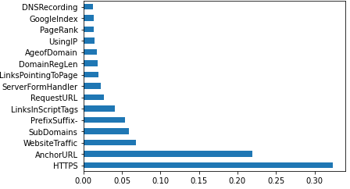
Feature Selection
Feature Importance Technique :
Feature importance gives a score for each feature of your data, the higher the score more important or relevant is the feature towards the output variable.
Feature Selection is one of the core concepts of Machine Learning which hugely impacts the performance of the model. Irrelevant or partially relevant features can negatively impact model performance.

Slide 7
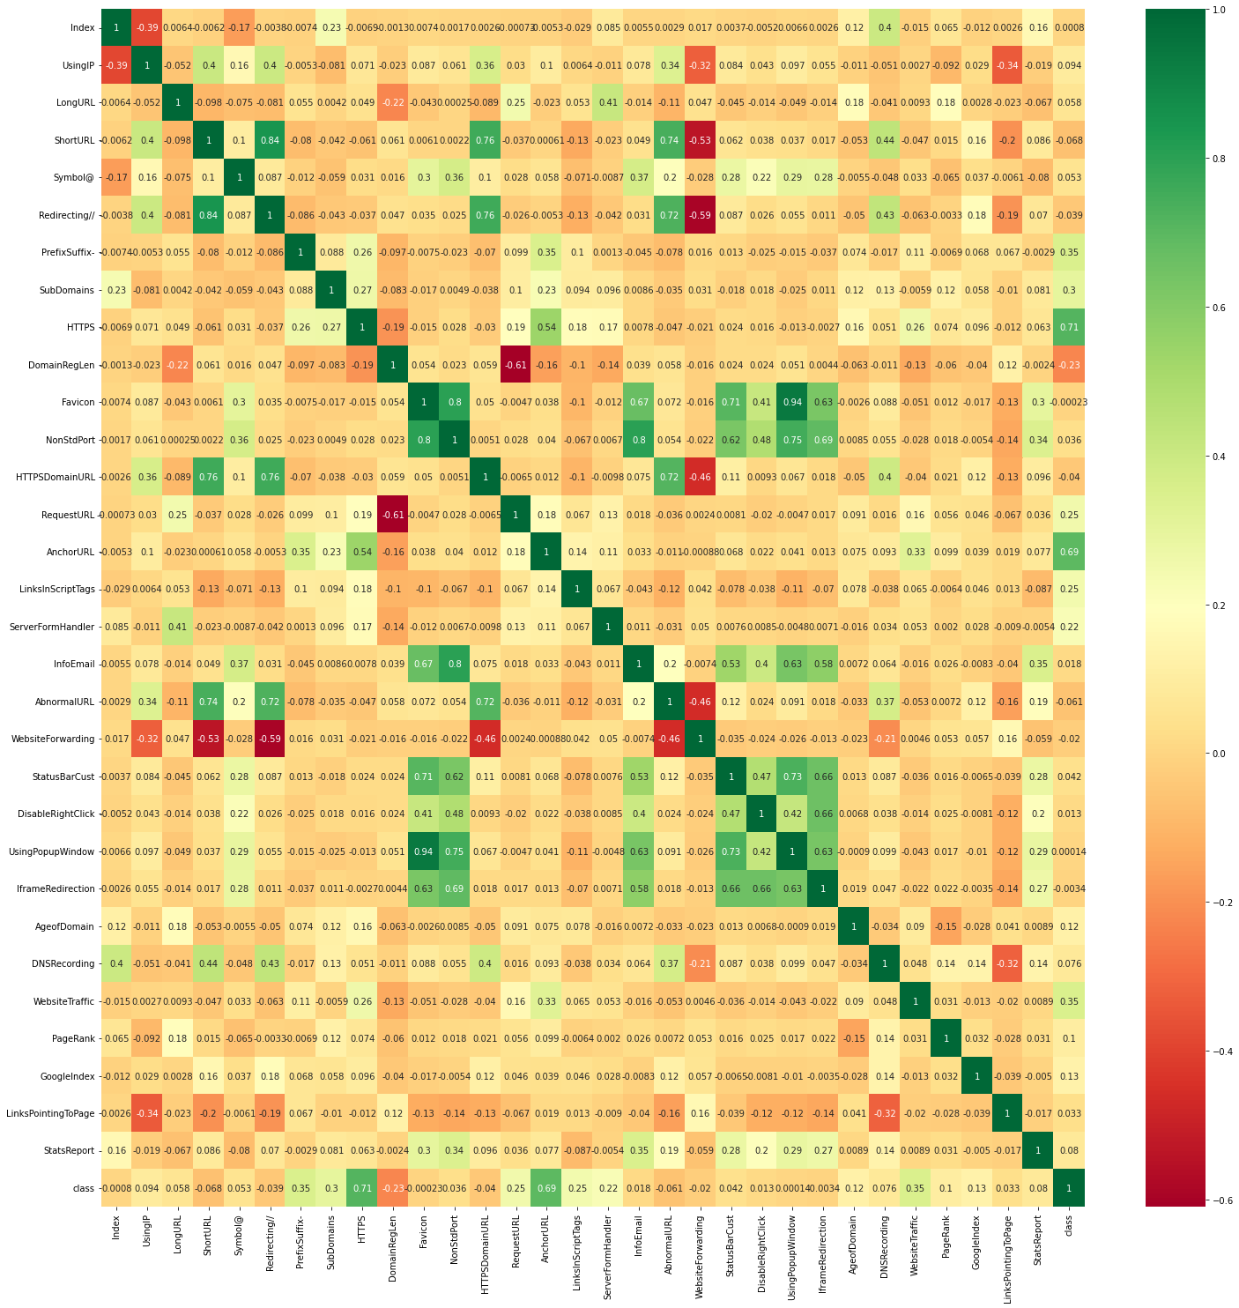
Feature Selection
Correlation Matrix with Heatmap :
Correlation states how the features are related to each other or the target variable. Correlation can be positive (increase in one value of feature increases the value of the target variable) or negative (increase in one value of feature decreases the value of the target variable)Heatmap makes it easy to identify which features are most related to the target variable, we will plot heatmap of correlated features using the seaborn library.

Slide 8
ML Algorithms Used
We have used the following Machine Learning Algorithms to design the classifiers:
Logistic Regression
Decision Tree
KNN
SVM
Naive Bayes
Random Forest
ADA Boost
XGBoost

Slide 9
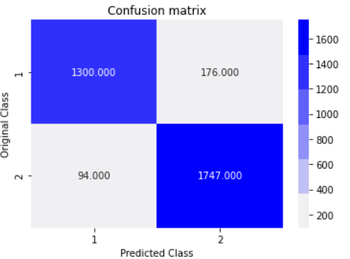
Logistic Regression Model
Logistic regression is a supervised learning classification algorithm used to predict the probability of a target variable. The nature of target or dependent variable is dichotomous, which means there would be only two possible classes.
Accuracy | Precision | Recall | F1-score
0.92 | 0.88 | 0.93 | 0.91

Slide 10
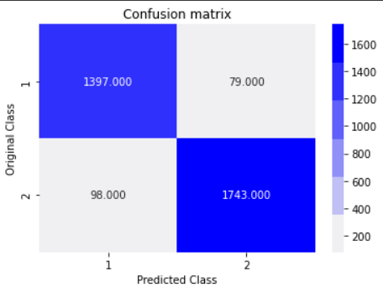
Decision Tree Model
Decision Trees are a type of Supervised Machine Learning where the data is continuously split according to a certain parameter. The tree can be explained by two entities, namely decision nodes and leaves. The leaves are the decisions or the final outcomes and the decision nodes are where the data is split.
Accuracy | Precision | Recall | F1-score
0.95 | 0.95 | 0.94 | 0.94

Slide 11
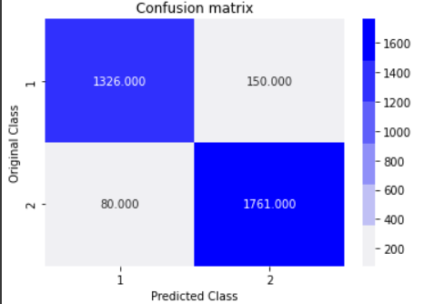
KNN Model
The abbreviation KNN stands for “K-Nearest Neighbour”. It is a supervised machine learning algorithm. The algorithm can be used to solve both classification and regression problem statements.
Accuracy | Precision | Recall | F1-score
0.93 | 0.90 | 0.94 | 0.92

Slide 12

Support Vector Machine Model
Support-vector machine are supervised learning models with associated learning algorithms that analyze data for classification and regression analysis.
Accuracy | Precision | Recall | F1-score
0.93 | 0.90 | 0.95 | 0.92

Slide 13
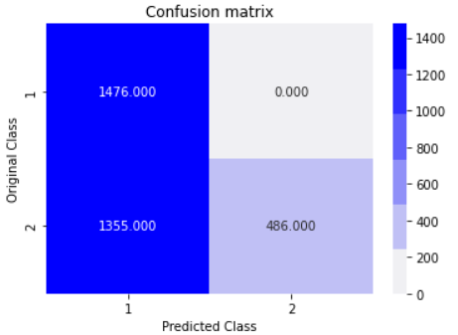
Naive Bayes Model
Naïve Bayes algorithm is a supervised learning algorithm, which is based on Bayes theorem and used for solving classification problems.
Accuracy | Precision | Recall | F1-score
0.59 | 1 | 0.52 | 0.69

Slide 14


Random Forest Model
Random forests or random decision forests are an ensemble learning method for classification, regression and other tasks that operates by constructing a multitude of decision trees at training time. For classification tasks, the output of the random forest is the class selected by most trees.
Accuracy | Precision | Recall | F1-score
0.95 | 0.95 | 0.95 | 0.95

Slide 15
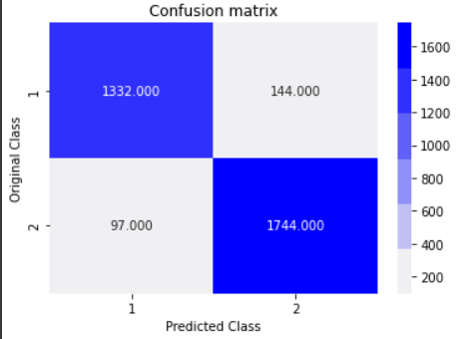
ADA Boost
Model
AdaBoost algorithm, short for Adaptive Boosting, is a Boosting technique used as an Ensemble Method in Machine Learning. It is called Adaptive Boosting as the weights are re-assigned to each instance, with higher weights assigned to incorrectly classified instances.
Accuracy | Precision | Recall | F1-score
0.93 | 0.90 | 0.93 | 0.92

Slide 16
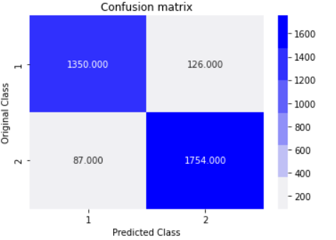
XGBoost Model
XGBoost is an implementation of gradient boosted decision trees designed for speed and performance. The library is laser focused on computational speed and model performance, as such there are few frills. It does offer a number of advanced features.
Accuracy | Precision | Recall | F1-score
0.94 | 0.91 | 0.94 | 0.93

Slide 17
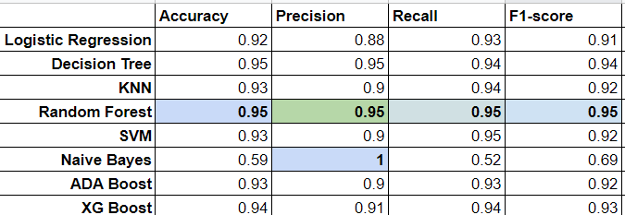
Comparing the Models
By comparing and analysing all the models we find that the Random Forest model outperforms every other model in almost all the metrics.

Slide 18
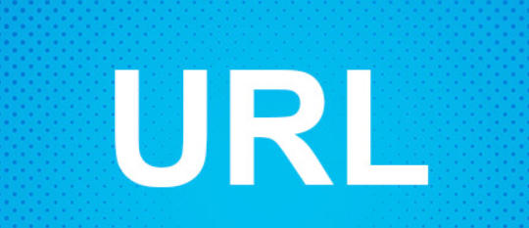
Application
Live URL —> Classification (-1,1)
Legitimate
??????
Fraudulent
??????

Slide 19
Preparing URL for Model Input:
Https : The existence of HTTPS is very important in giving the impression of website legitimacy as HTTPS is far more secure than HTTP Output : 1 (not https hence may be phishy) -1 (https hence legitimate url)
URL_of_anchor(<a>) : The domain name of most of the <a> tags present on the website must be same as that of the url Output : returns -1 (legitimate) returns 1 (phishy)
Website_Traffic : This feature measures the popularity of the website by determining the number of visitors and the number of pages they visit. If the domain has no traffic or is not recognized by the Alexa database, it is classified as “Phishing”. Output : IF
Website Rank < 100,000 → returns 1 (legitimate)
Website Rank > 100,000 → returns -1 (phishy)

Slide 20
Sub domains and multi-sub domain : In this feature, we are checking if the subdomains of the links present on the website are same as that of the url of our website. Any url may or may not contain a sub-domain other than ‘www’. If
No subdomain present : returns -1 (legitimate)
One subdomain ( like second level domains eg. ‘.in’ , ‘.uk’): returns 0
One subdomain ( like second level domains eg. ‘.in’ , ‘.uk’): returns 0 (suspicious)
More than one subdomains : returns 1 (phishy)
PrefixSuffix: If we find a hyphen (-) in domain than that URL is malicious.
Returns 1 if URL is malicious
Returns 0 if URL is legitimate
LinksInScriptTags: If we take the percentage of the script tags have domain name in their src different from the domain in URL to be x then
If x<17% :Returns -1 to signify that URL is legitimate
If 17< x <=81%: Returns 0 to signify URL is suspicious else Returns 1 to signify that URL is malicious.

Slide 21
AgeOfDomain : This feature can be extracted from WHOIS database. Most phishing websites live for a short period of time. By reviewing our dataset, we find that the minimum age of the legitimate domain is 6 months.
If Age of domain < 6 months : returns 1 (phishy)
If Age of domain > 6 months : returns -1 (legitimate)
Using IP address : If an IP address is used as an alternative of the domain name in the URL, such as “http://125.98.3.123/fake.html”, users can be sure that someone is trying to steal their personal information. Sometimes, the IP address is even transformed into hexadecimal code as shown in the following link “http://0x58.0xCC.0xCA.0x62/2/paypal.ca/index.html”.
If the domain name is an IP address then the URL is malicious else the URL is legitimate.
Returns 1 if the URL is malicious
Returns -1 if the URL is legitimate

Slide 22
ServerFormHandler : If any form is present on the website then we check if the domain name of link provided in action inside form is equal to the domain in URL or not. If it is not then URL is suspicious and if the action is left blank then URL is malicious.
RequestURL : This feature checks whether the path links of the external objects present on the webpage like images, videos, sounds etc. are loaded from different domain.
DomainRegLen : We check the difference between termination time and current time (Domain_End).
If the URL expires on < 6 months : returns 1 (phishy)
If URL expires on > 6 months: returns -1 (legitimate)

Slide 23


Slide 24
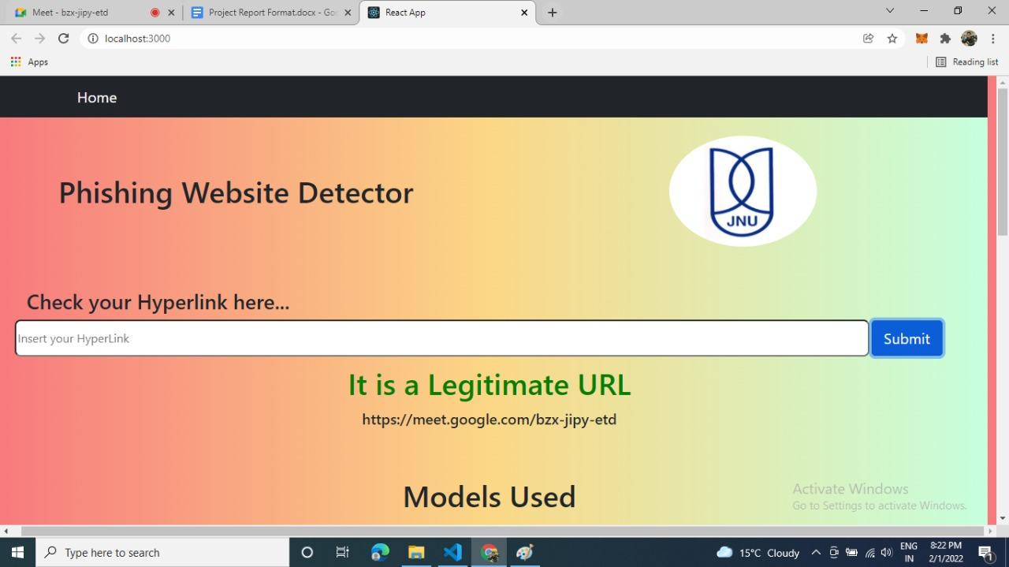
https://meet.google.com/bzx-jipy-etd (legitimate URL)

Slide 25
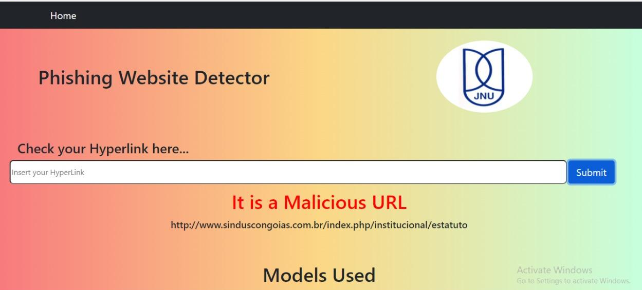
http://www.sinduscongoias.com.br/index.php/institucional/estatuto (phishy URL)

Slide 26
Bibliography
[1] Rishikesh Mahajan, “Phishing Website Detection using Machine Learning Algorithms 2018”
[2] https://www.alexa.com/login/
[3] https://in.godaddy.com/offers/whois-b?
[4] Rami M. Mohammed and Fadi Thabtah “Phishing Websites Features”

Slide 27
Thank you for your patience….

